Slide 1
Odontoceti click trains detection
CARI’MAM Project
Pierre Mahé, Nicolas Deloustal, Paul Best, Maxence Ferarri, Marion Poupard, Hervé Glotin
mahe.bioacoustics@gmail.com
15 Mars 2023

Slide 2
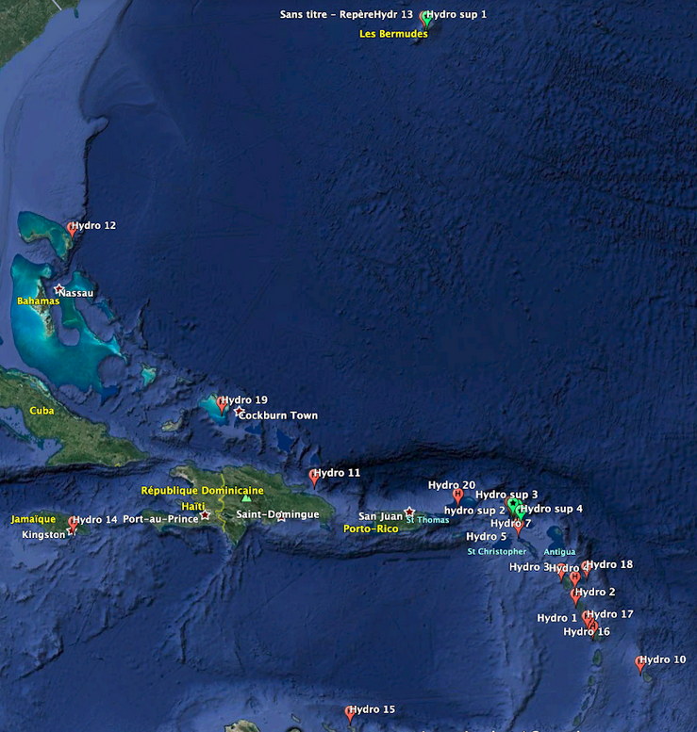
Audio Data
The Antilles is a biodiversity hotspot with more than 20 cetacean species.
In terms of odontoceti species :
Dauphins (Pantropical, Fraser's, Sotaliea…)
Beaked whales (Koggia, Ziphus…)
Sperm Whale

Slide 3
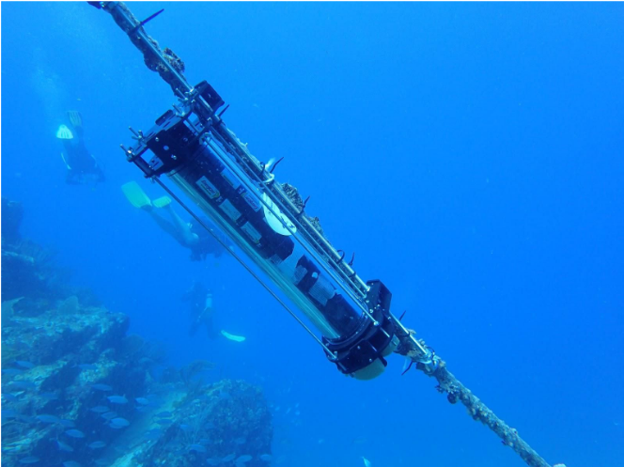
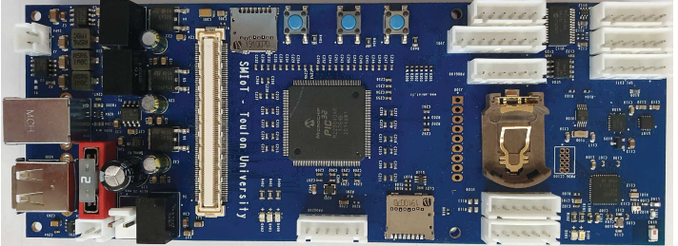
Audio Data
Caractéristique des enregistrements :
Discontinuous recording, 1 min every 6 mins
Audio sample rate: 512kHz
800k files, about ~8500 hours of recording
The sound card is designed by SMIOT at Toulon university. It proved high sample rate, low electronic noise.

Slide 4
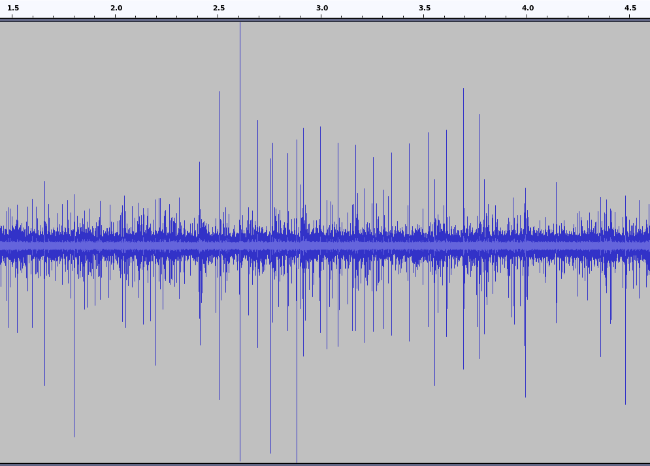
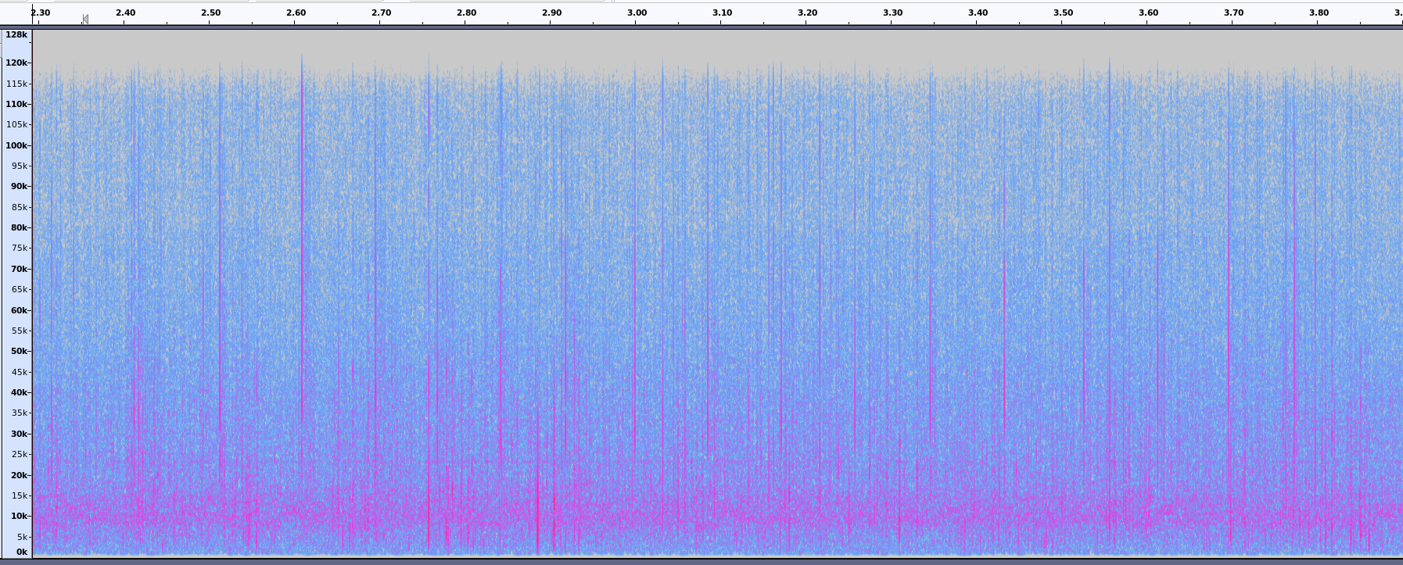
Audio Data
Project specificity
Buoys are near the coast (depth < 80m)
Strong background noise, lot of transients (reef noise, shrimps)
⇒ It’s hard to differentiate Odontoceti clicks and background transient

Slide 5
Purpose of the study
Detect the presence of odontocetes by clicks train analysis.
Needs to create a click detector (binary classification).
Isolate noise / anthropogenic transient and odontocetes.
Why only used clicks ?
Technical challenge, less studies on clicks than whistlings for dolphins
Continuous indication of odontoceti presence
Our hypothesis, clicks are less individual/group dependant than the whistlings

Slide 6
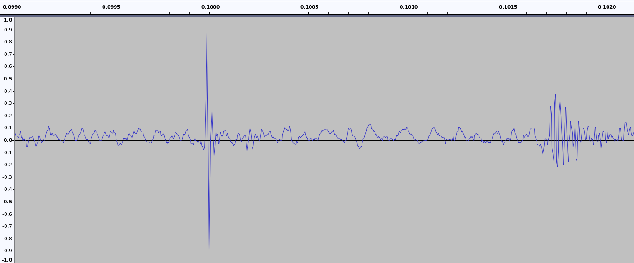
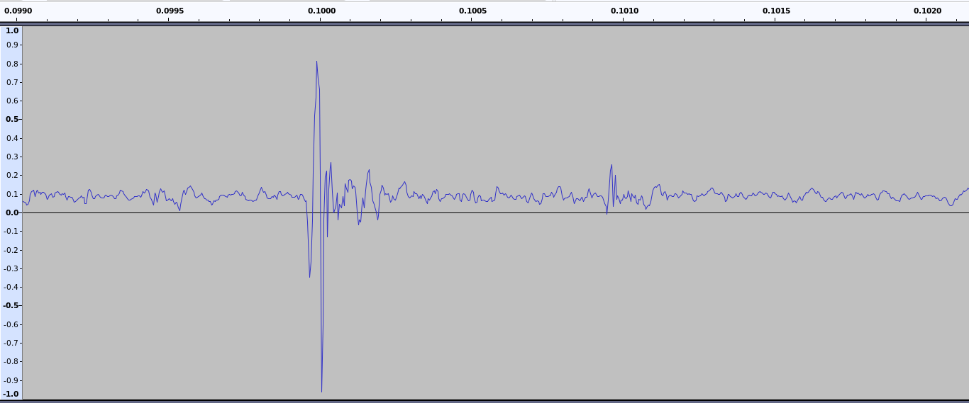
One-click detector
Input of the model is a 2ms signal frame.
Short frame is used to force the detector to focus on frequency structure.
Example of click
Example of noise transient

Slide 7
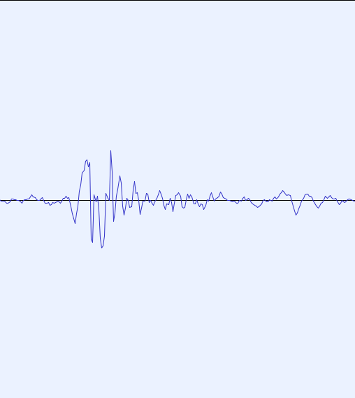
One-click detector
Input of the model is a 2ms signal frame.
Short frame is used to force the detector to focus on frequency structure.
2ms
Detector
(CNN)
Binary Prediction
2ms

Slide 8
One-click detector
Annotations details :
Hand made
Partial annotation of click trains
230 files annotated across 11 sessions
25k click annotations (positive/negative)

Slide 9
One-click detector
Performance
False positive ratio
FPR = 0,02
False positive per minute
FP/min ≈ 1000
 | Accuracy | Precision | Recall | ROC AUC
Train | 0,92 | 0,93 | 0,87 | 0,95
Test | 0,91 | 0,96 | 0,88 | 0,96

Slide 10
From clicks detection to odontoceti passages
To limit false detection, a filter post-processing is applied:
Aggregation of the NN prediction (1s)
Quantile 99 computation
Adaptive threshold (2x std of activity peer station and peer hours)
Counting the number of 1s-frame over the threshold
From those positive 1s-frames, timetables are generated for each station

Slide 11
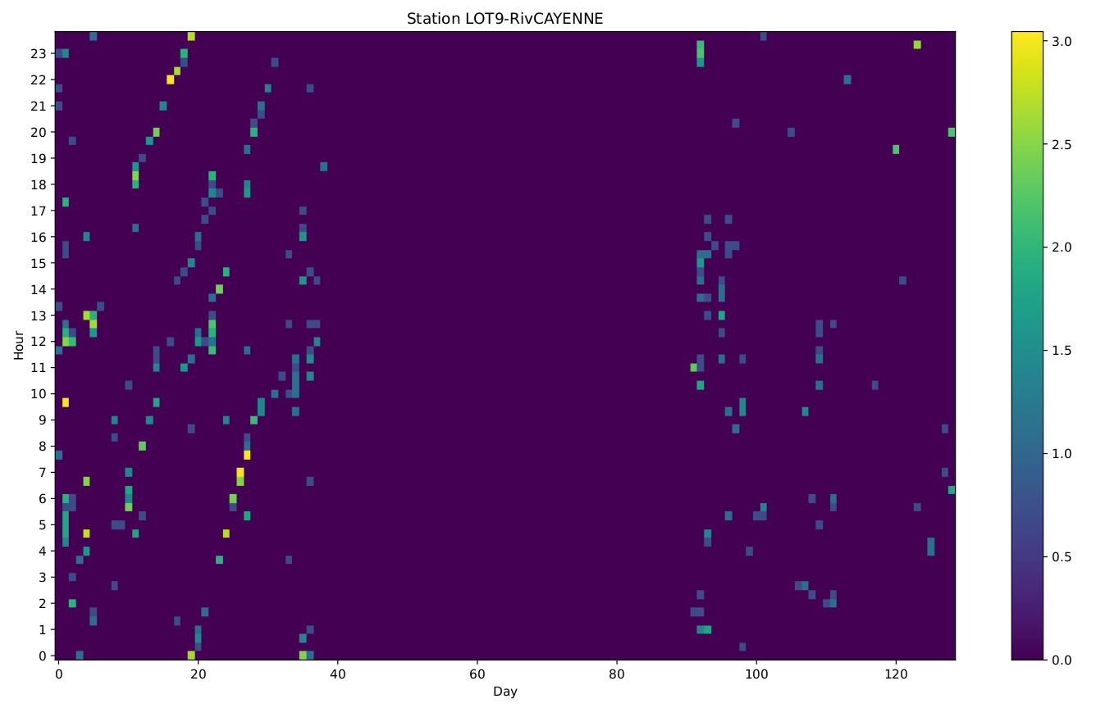
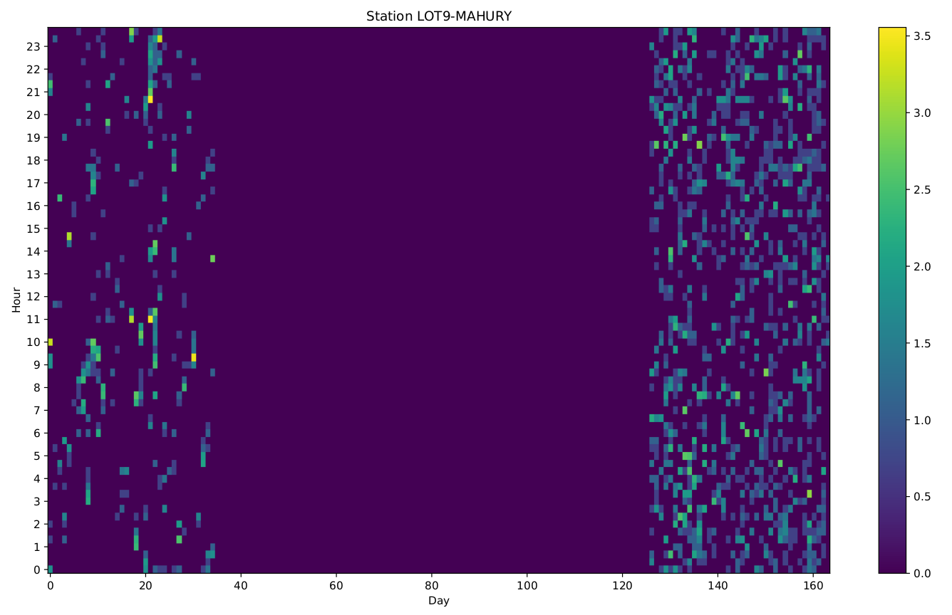
From clicks detection to odontoceti passages
Timetable of 1s-frame detection peer station
1
2
3
?
4
‹#›

Slide 12

From clicks detection to odontoceti passages
The post-process improves prediction. But improvement is not quantified yet.
At first sight, to improve overload detection performance, the one-click detector needs to be extended.
This extension allows the model to take into account the time position and add context.
Detector one-click
(prediction)
Embedding
Context
Prediction for a file

Slide 13
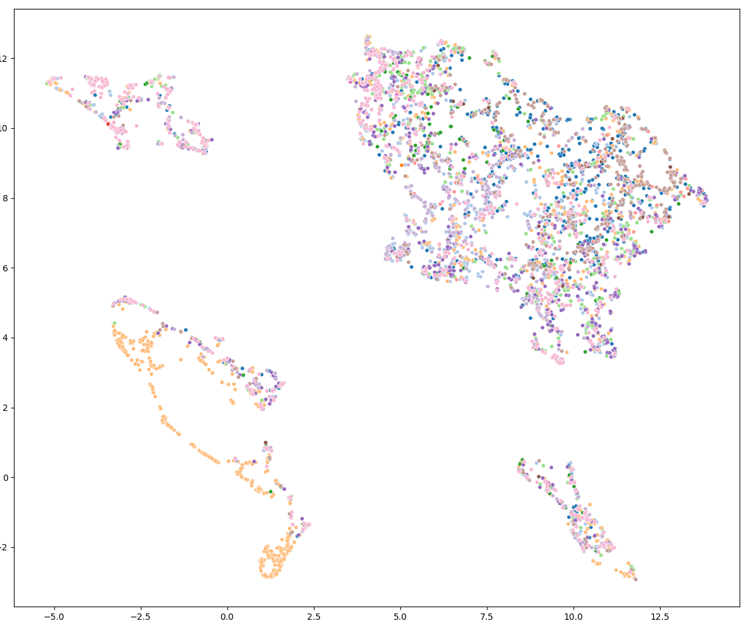
Sotalie - Clicks type classification
Feature extraction :
  Centroid Frequency
  Mean Frequency
  Band width
  Skewness
  Kurtosis
  Min/max frequency and energy
Dimensionality reduction (UMAP)

Slide 14
Sotalie - Clicks type classification
Feature extraction :
  Centroid Frequency
  Mean Frequency
  Band width
  Skewness
  Kurtosis
  Min/max frequency and energy
Dimensionality reduction (UMAP)
Buzz

Slide 15

Task provide to a Deep Learning challenge
A Clicks detection task has been proposed by our team to the Challenge Data (organiZed by ENS and the Collège de France).
https://challengedata.ens.fr/challenges/85
Task results will be published in a few weeks.

Slide 16
Thanks for your attention
Any questions ?
Pierre Mahé, Nicolas Deloustal, Paul Best, Maxence Ferarri, Marion Poupard, Hervé Glotin
mahe.bioacoustics@gmail.com
15 Mars 2023

