Slide 1


Slide 2
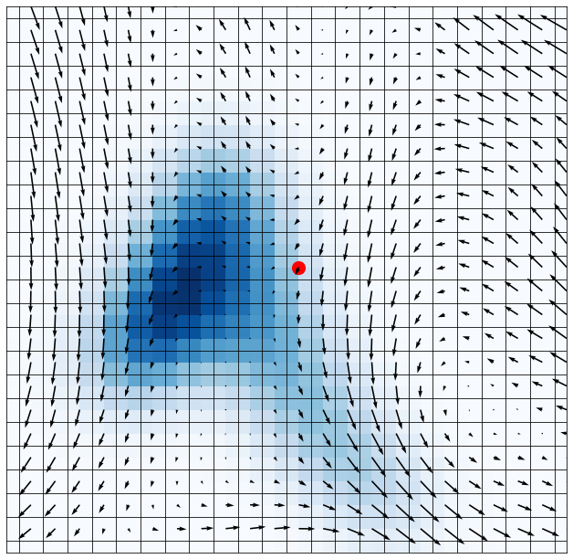
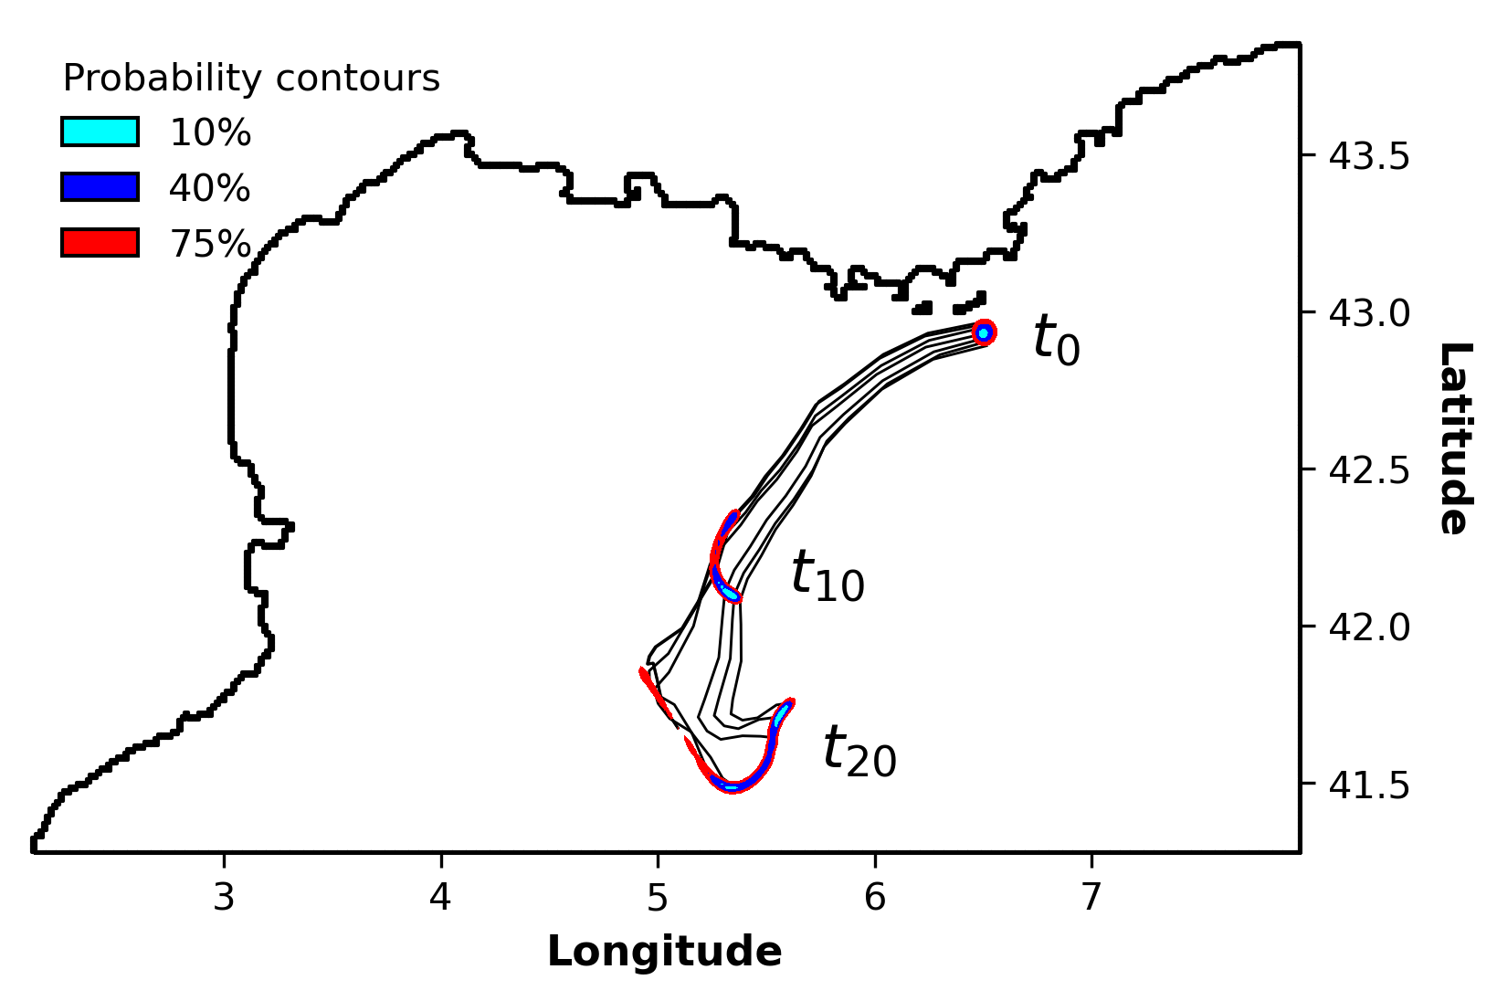
Current forecasting
Generating a dataset of simulated probabilistic trajectories
Uncertain particle drift over 1 timestep
Uncertainty compounded over several timesteps
5 km
uncertainty radius
Using currents from a high-resolution model in the north-west Mediterranean Sea

Slide 3
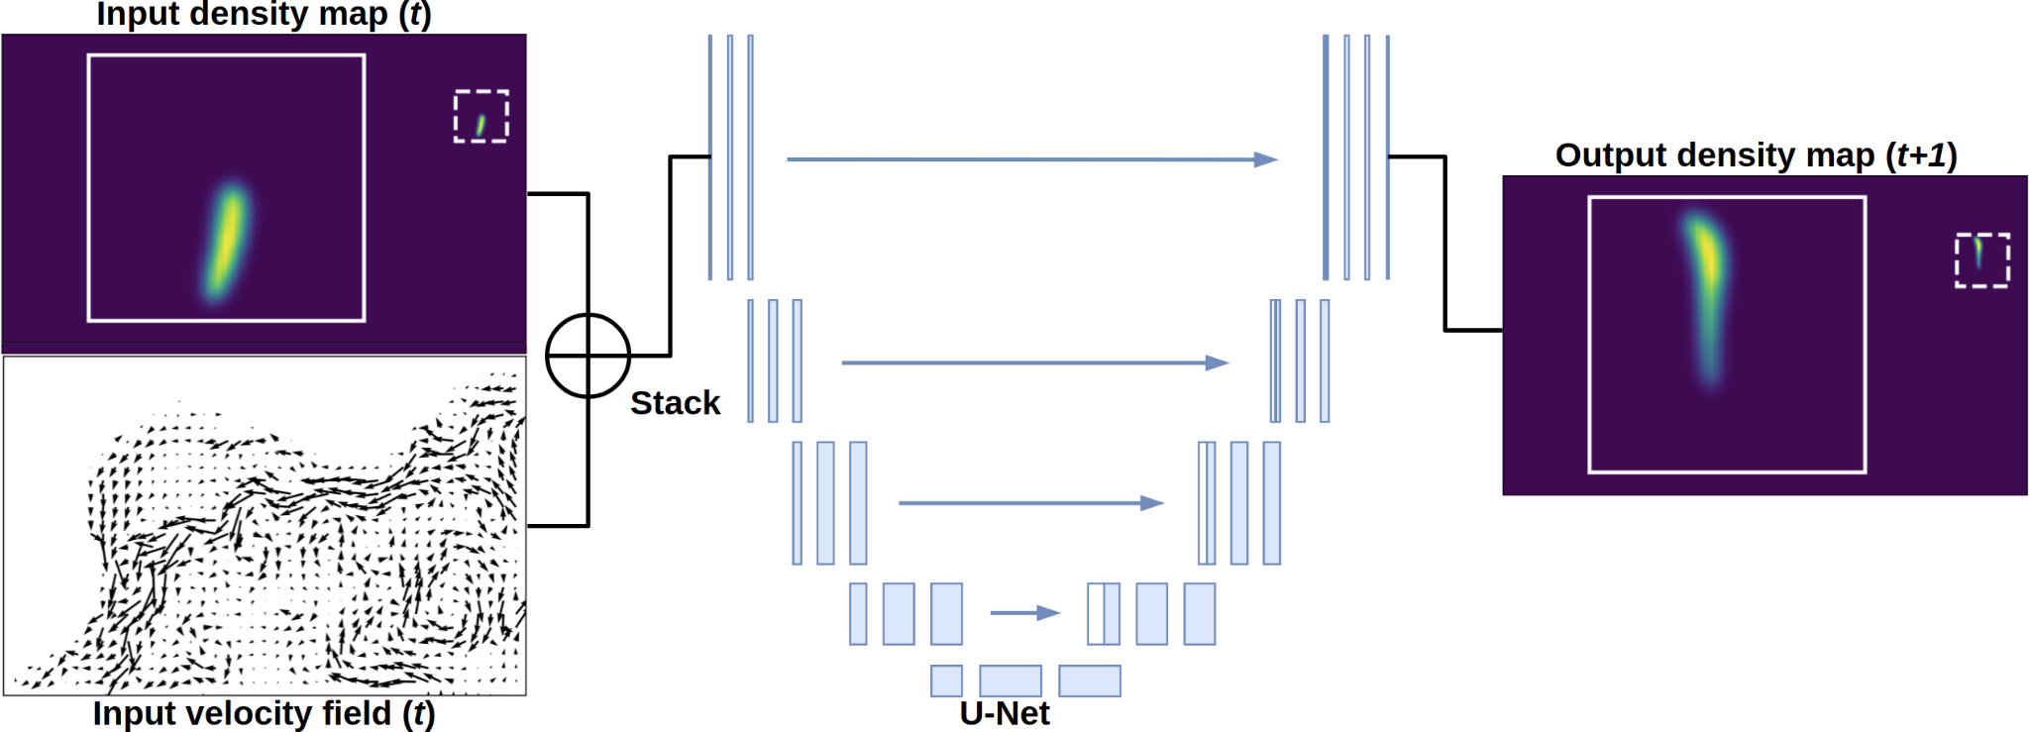
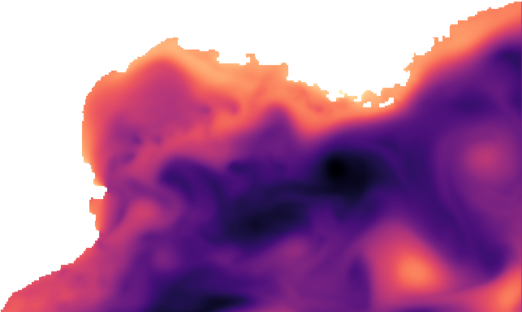
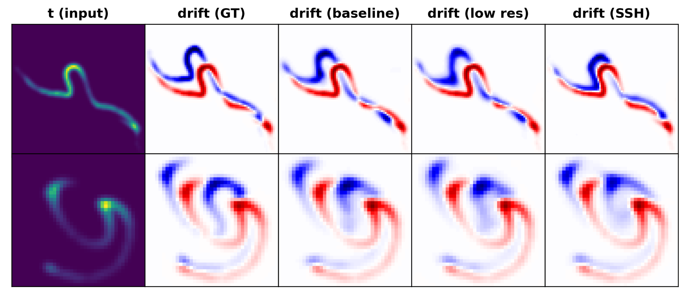
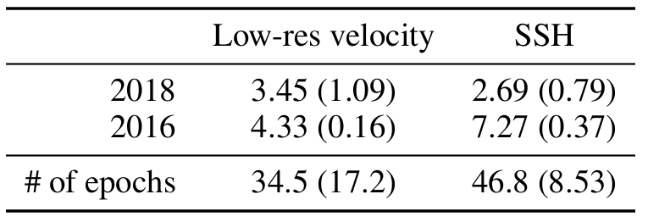
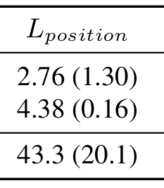
Flexible framework for training on various input data
Replace with e.g.
Low-res velocity
SSH
SSH
Re-trained with different inputs
Baseline
(high-res velocity)
2016
Promising performance to different inputs
Future work: forecast probabilistic trajectories with errors in the input data
2018

Slide 4
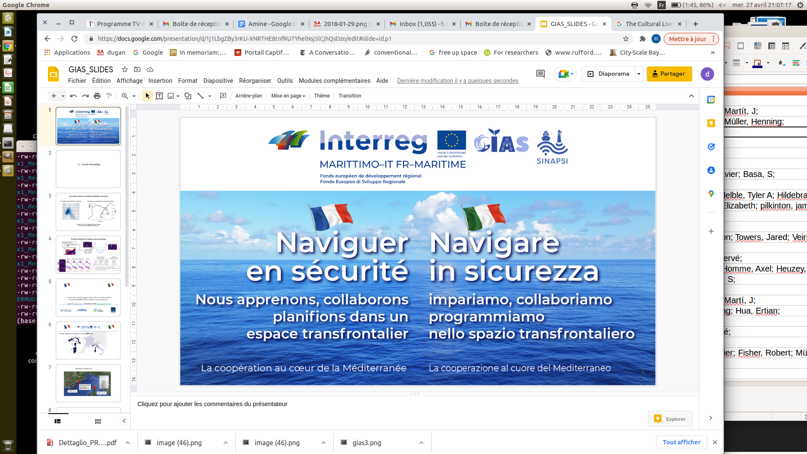






2) Sécurité de la Navigation dans la Zone Transfrontalière
Bouée IA BOMBYX Anti-Collision Cétacés-Bateaux
contact Pr glotin@univ-tln.fr, UTLN CNRS LIS DYNI http://bioacoustics.lis-lab.fr

Slide 5

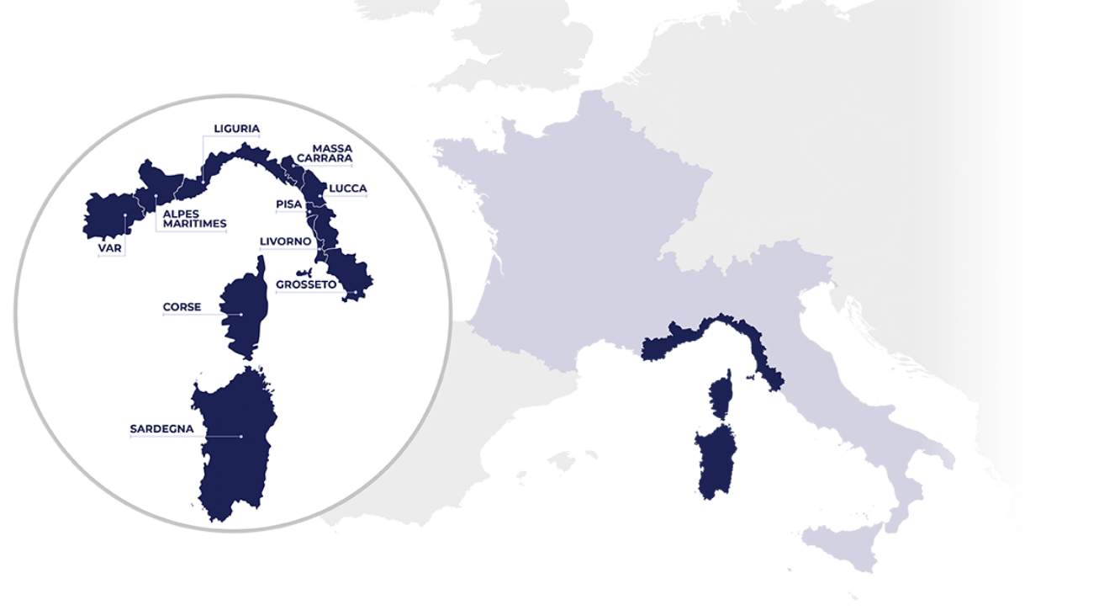
Bombyx déploiement en mai 2022, au centre de MARITTIMO

Slide 6
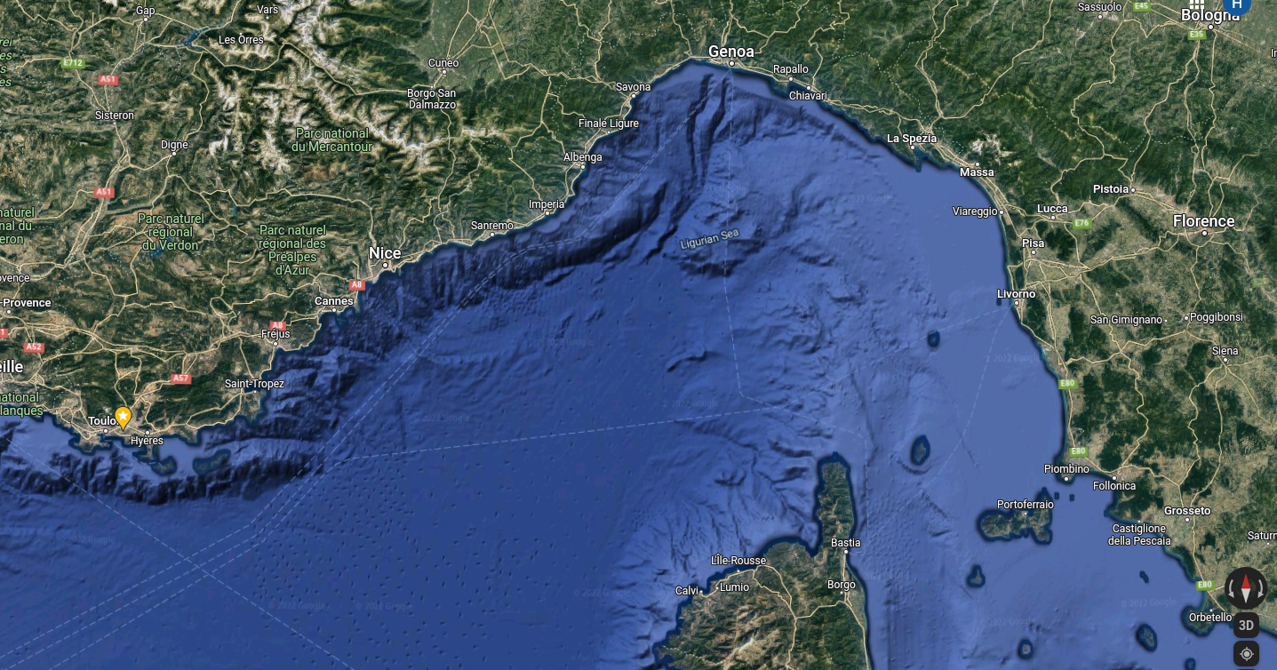
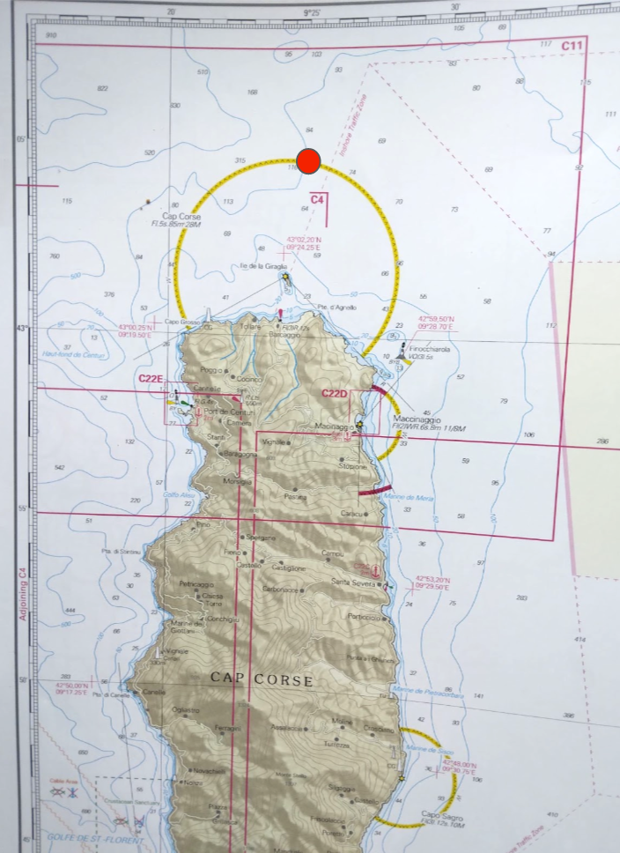
Optimisation of the placements
BX1
habitat of Cachalot
and rorqual &
high collision risk
BX2
military reason
habitat reason

Slide 7
Apprendre à décider des vraies alertes
de présence des cétacés

Slide 8
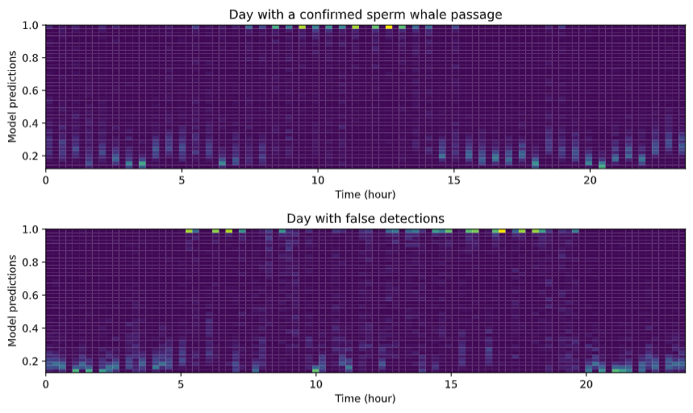
Donner l’alerte sur les rapports des détections de BOMBYX
construction des densigrammes, exemples sur Bombyx1 (Toulon 2017)
density
of the probabilities
of detection of cachalot
Real data,
7 july 2015
with cachalot =
8th sept 2017,
without cachalot =

Slide 9
Donner l’alerte sur les rapports des détections de BOMBYX
construction des densigrammes, exemples sur Bombyx1 (Toulon 2017)
density
of the probabilities
of detection of cachalot
Real data, one day
summer 2017,
with cachalot =
without cachalot =
smooth variations = true alert
no continuity = no alert

Slide 10
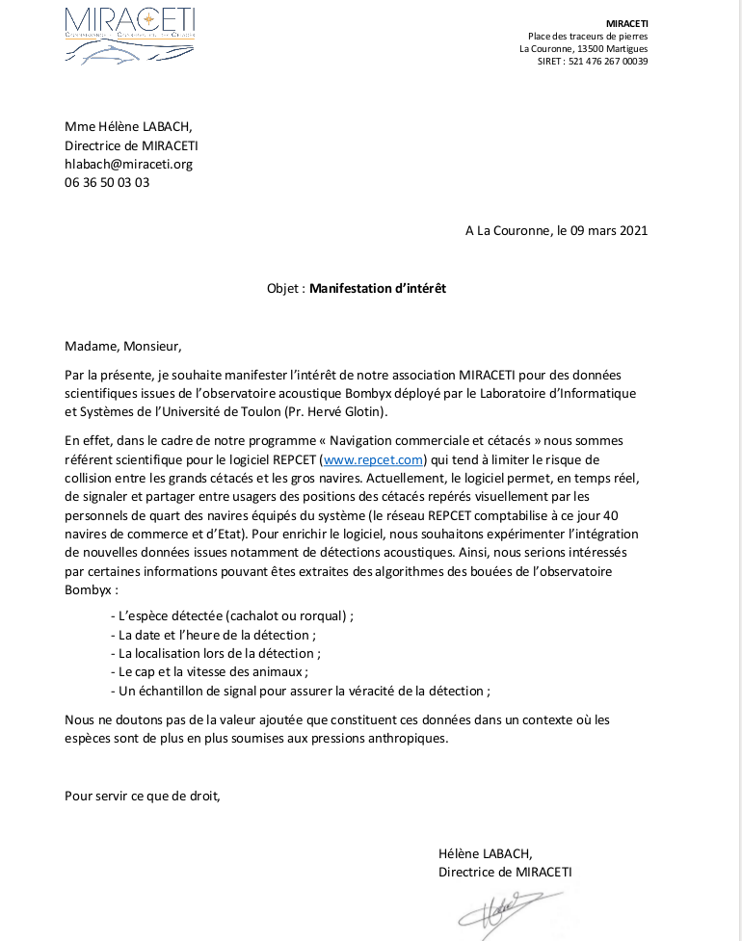
Usage of BOMBYX via REPCET :

Slide 11
Global system GIAS Bombyx DYNI
TOULON LIS LAB
density analysis
MIRACETI
Final decision & Alert SMS
to REPCET
GSM emission to UTLN of the
detection &
.wav samples
dive
azimuth,
distance, direction estimation
surface
Bombyx
sonobuoy
Decision to surface
feedback for next decision
Web map of historic
Alert to the
boats
Bombyx recording
Embedded
detections
AIS

